Slide 1
KYTC District 6 “Great Eight” Incident Management Task Force
July 15, 2014

Slide 2
Introductions

Slide 3
Approval of Minutes
4/8/14 Meeting

Slide 4
Meeting Theme
SAND or FLOOR DRY (KITTY LITTER)

Slide 5
Incident Review
I-75 SB Fuel Spill on 4/9/14 @ MP 186.4
Kenton County

Slide 6
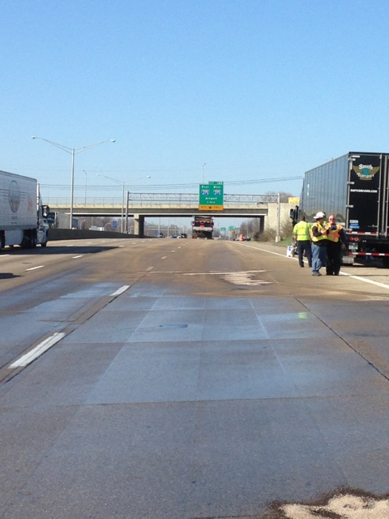

Slide 7
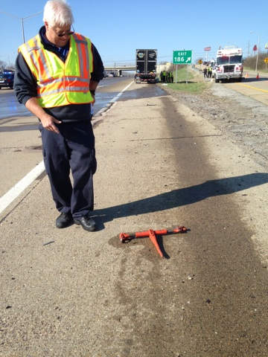

Slide 8
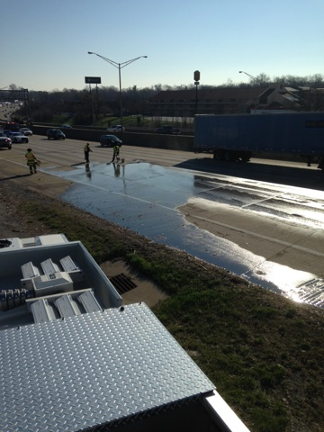

Slide 9
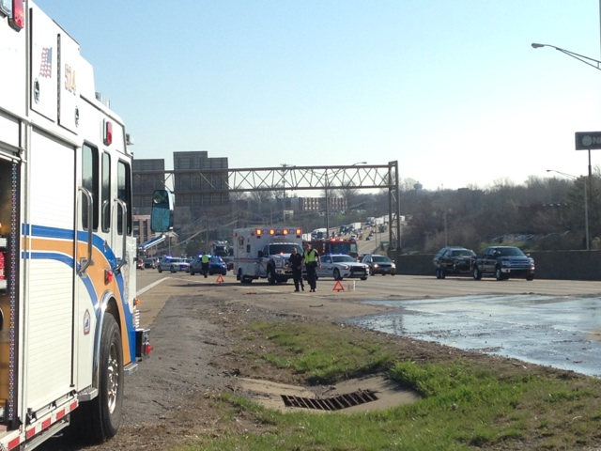

Slide 10
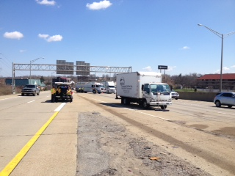

Slide 11
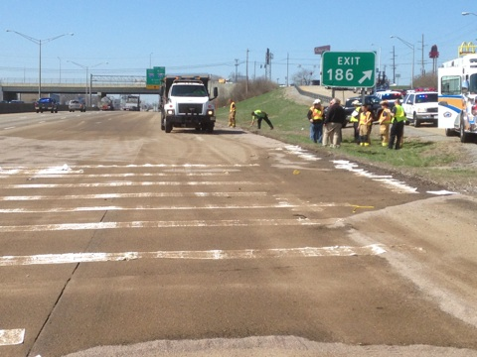

Slide 12
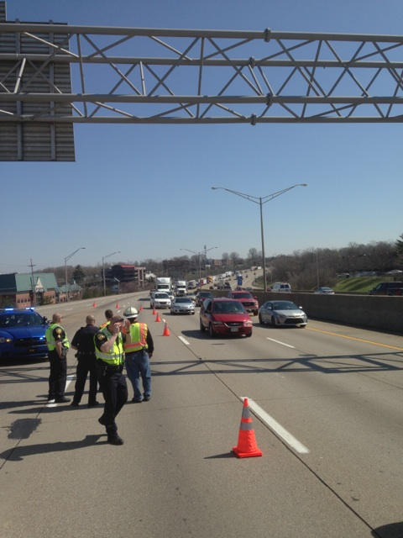

Slide 13
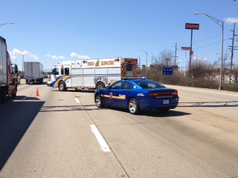

Slide 14
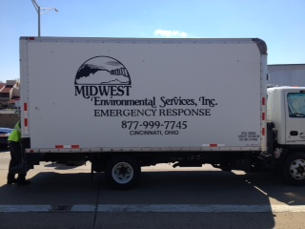

Slide 15
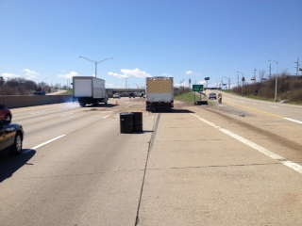

Slide 16
Incident Review
I-71 NB Bridge Strike on 4/23/14 @ KY 562 Overpass
Gallatin County

Slide 17
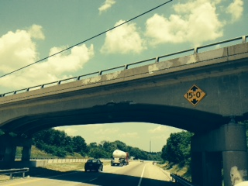

Slide 18
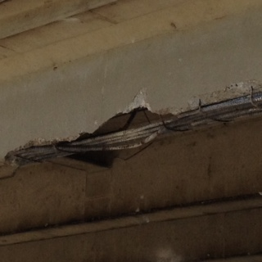

Slide 19
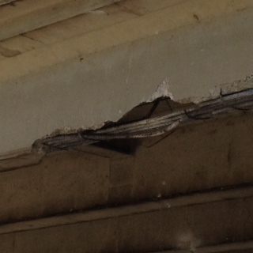

Slide 20
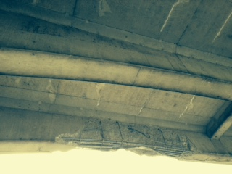

Slide 21
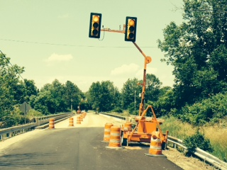

Slide 22
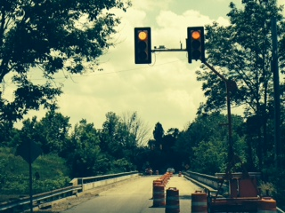

Slide 23
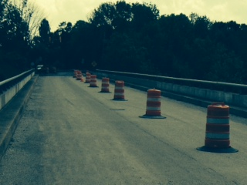

Slide 24
Incident Review
I-71 NB Secondary Crash on 4/23/2014 @ MP 60.3
Gallatin County

Slide 29
Incident Review
Motorcycle Fatality on 5/22/14 @ Donaldson Rd. Entrance Ramp to I-75 & I-275
Kenton County

Slide 30
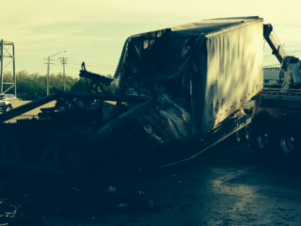

Slide 31
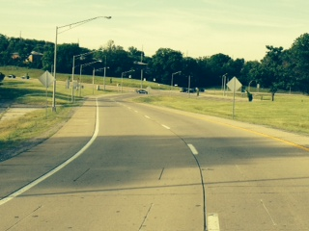

Slide 32
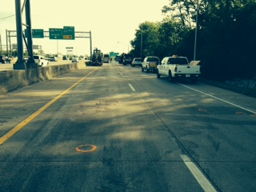

Slide 33
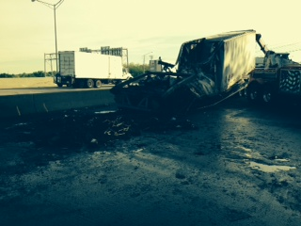

Slide 34
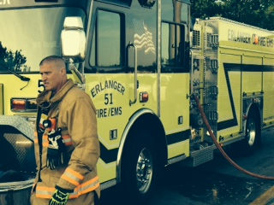

Slide 35
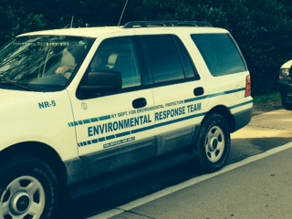

Slide 36
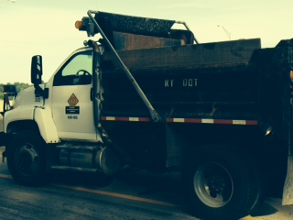

Slide 37
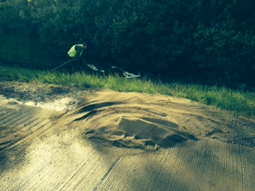

Slide 38
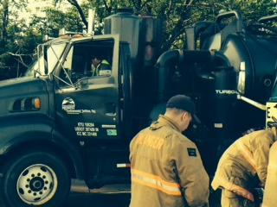

Slide 39
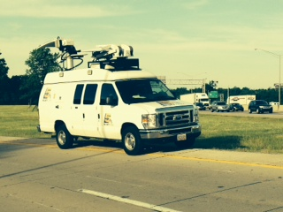

Slide 41
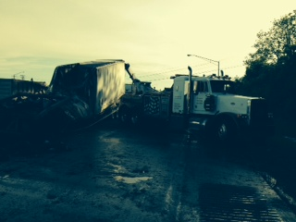

Slide 42
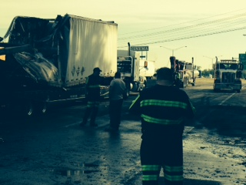

Slide 43
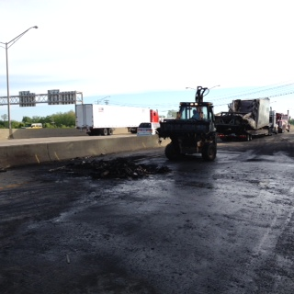

Slide 44
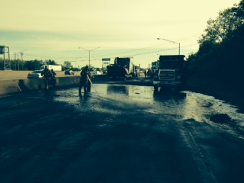

Slide 45
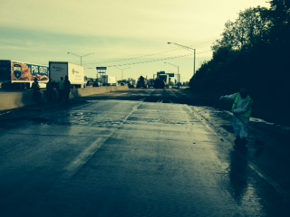

Slide 46
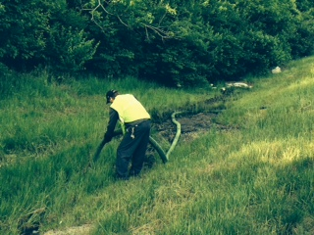

Slide 47
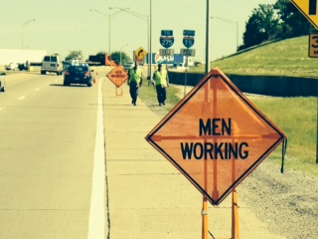

Slide 48
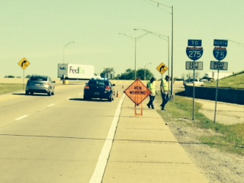

Slide 49
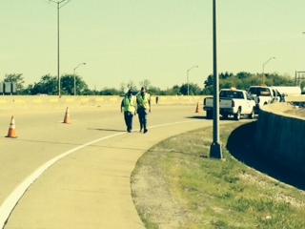

Slide 50
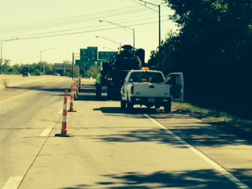

Slide 51
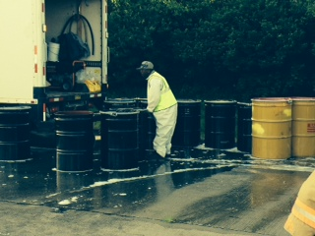

Slide 52
Incident Review
I-471 SB Ramp to US 27 Concrete Truck Rollover on 6/20/2014 @ MP 1.8
Campbell County

Slide 53
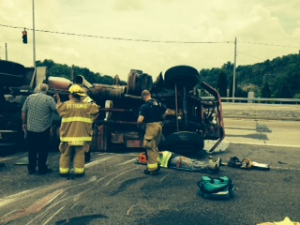

Slide 54
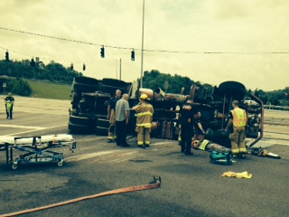

Slide 55
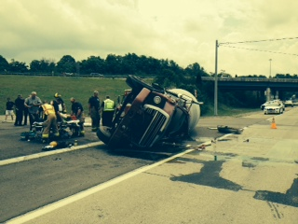

Slide 56
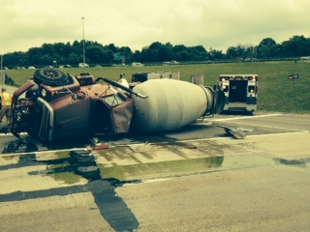

Slide 57
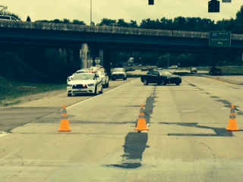

Slide 58
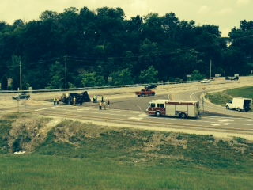

Slide 59
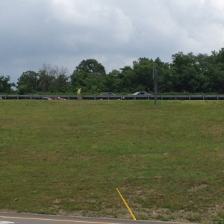

Slide 60
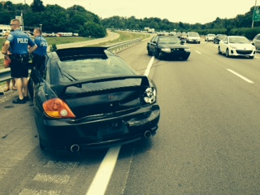

Slide 61
Crash Statistics
Quarterly Crash Statistics
KSP CRASH Database
Valerie Januski
District 6 Safety Officer

Slide 62
Southeast Counties

Slide 68
Southwest Counties

Slide 74
Yearly Crash Comparison by Route Type
Pendleton County
Grant County

Slide 78
Construction Update

Slide 79
Incident Management Training

Slide 80
Other Business
Information Sharing

Slide 81
Adjourn
Next Meeting
Tuesday October 7, 2014
1:00 PM

